Slide 1
Predict tracks that could belong to a playlist with Knowledge Graph Embeddings
Big-Data Praktikum 2024
Leipzig, 02.08.2024
Asel Baibekova
Supervisor: Daniel Obraczka
Notes:
Entered text
Collaboration and Teamwork

Slide 2
Structure
Problem
Basics
Technology
Results

Slide 3
Playlist Link Prediction
The aim of this exercise is to develop a model which can complete playlists by predicting links between tracks and playlists.
Goal: Transform MySQL tables stored as .parquet files into a knowledge graph, train a link prediction model on this knowledge graph, and evaluate the model on a specific relation.
Process Steps:
  Data Extraction: Retrieve MySQL table data from .parquet files.
  Knowledge Graph Construction: Convert table data into a structured knowledge graph.
  Model Training and Evaluation: Train a link prediction model and assess its performance.
Problem and Project Overview

Slide 4
What is Knowledge Graph
Link Prediction
Problem
Basics
Technology
Results

Slide 5
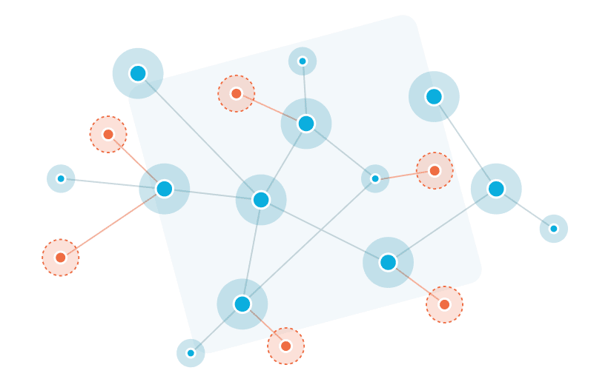
A knowledge graph is a network of real-world entities (like people, places, and things) interconnected by relationships. It structures factual information and enables it to be inferable through logical queries
What is a Knowledge Graph?

Slide 6
Entities: primary objects (nodes) in the graph, such as people, locations, or organizations
Relationships: connections (edges) between entities, representing how entities are related to one another
Attributes: Information that provides more details about entities, not necessarily connecting them to other entities
Components of a Knowledge Graph

Slide 7
Information Retrieval: Enhance the search capabilities by understanding the context and relationships between entities
Recommendation Systems: Improve the accuracy of recommendations by analyzing the interconnected nature of preferences and interests
Data Integration: Facilitate the integration of diverse data sources and provide a unified view of data across different domains
Importance of Knowledge Graphs

Slide 8
Involves forecasting new potential relationships or inferring missing links between nodes in a network
Helps in uncovering hidden patterns, predicting future connections, and completing existing knowledge graphs
Improves the richness and usability of knowledge graphs by adding new, inferred relationships
Link Prediction

Slide 9
Scalability: Handling large-scale graphs efficiently while maintaining high predictive performance
Data Sparsity: Dealing with graphs that have a large number of nodes but relatively few edges
Dynamic Nature of Graphs: Adapting to continuously evolving graph data, where nodes and edges may appear or disappear over time
Common Challenges in Link Prediction

Slide 10
Hits@k measures the proportion of correct predictions (true positive links)
that appear within the top k positions of the ranked list produced by the model
Indicates the model's accuracy in identifying the most relevant entity connections
Commonly used thresholds are Hits@1, Hits@3 and Hits@10
A high Hits@1 score means the model often ranks the true link as its top choice
Mean rank is the average rank of the true entity when ranked against all possible entities
Lower values indicate better performance
Evaluation Metrics: Hits@k and Mean Rank

Slide 11
PyKEEN
Problem
Basics
Technology
Results

Slide 12
PyKEEN (Python KnowlEdge EmbeddiNgs) is an open-source Python library designed to train and evaluate knowledge graph embeddings
Facilitates machine learning on knowledge graphs with the aim of improving tasks such as link prediction, entity resolution, and entity classification
Wide Range of Models: like TransE, DistMult, ComplEx, and RotatE
Flexible Pipeline: Allows for comprehensive experiments with different combinations of models, training approaches, and evaluation metrics
Integrated Tools: Comes with tools for hyperparameter optimization, automatic benchmarking, and result analysis
PyKEEN

Slide 13
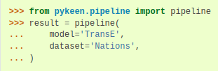
Loading a standard dataset
Selecting the 'TransE' model for training
Evaluating the model and printing the results
Briefly explanation

Slide 14
Pandas
Data manipulation and analysis in Python for medium-sized datasets
DataFrames and Series for structured data
Ideal for complex data analysis on single machines
Statistical analysis and machine learning data prep on datasets fitting in memory
PySpark
Large-scale data processing and big data applications
Distributed data handling with RDDs and DataFrames
Supports real-time processing and runs on clusters for parallel processing
Analyzing large datasets across multiple machines, real-time data streams
Data Transformation Tool
Comparing Pandas and PySpark

Slide 15
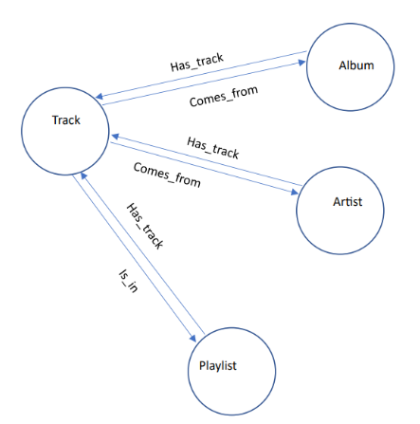
It consists of user-created as well as Spotify-curated
playlists. In total the dataset contains 1 million playlists,
3 million unique tracks, 3 million unique albums, and 1.3
million artists organized in the following tables and splitted into smaller Dataset 4.7GB with .parquet files
- album
- artist
- track
- playlist
- track_artist1
- track_playlist1
Dataset: Zenodo Spotify One Million Tracks

Slide 16
Results
Problem
Basics
Technology
Results

Slide 17
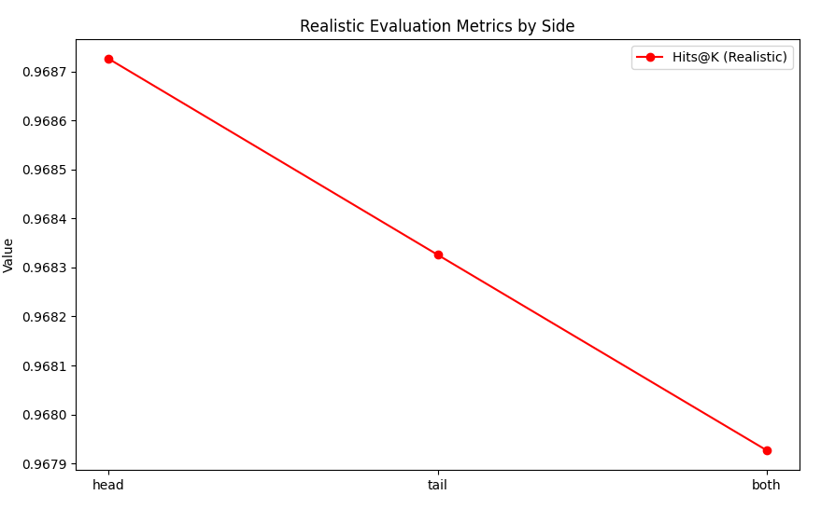
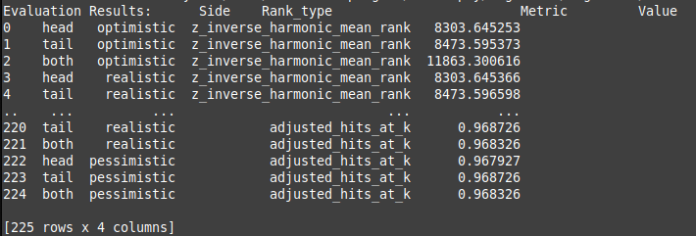
Trained on cuda:0 indicating GPU usage for faster computation
Model trained for 100 epochs performed on 56,400 triples
Hits@K Adjusted Performance (Realistic)
Realistic Hits at K: Approximately 0.968726
This high score indicates that nearly 97% of the correct predictions fall within the top K results
Reflects the model's strong capability in accurately identifying potential links under realistic testing conditions
Training PyKEEN. Model Training Overview.

Slide 18
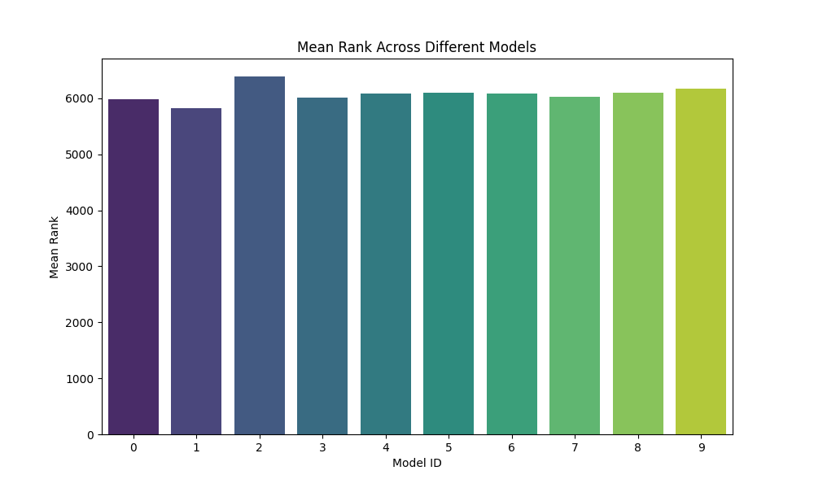
Mean Rank: The average rank position of the correct entities
predicted by the model
TransE_model_0.pth: 2.32 MB (2429762 bytes)
TransE_model_1.pth: 2.78 MB (2915586 bytes)
TransE_model_2.pth: 3.25 MB (3404290 bytes)
TransE_model_3.pth: 3.71 MB (3888130 bytes)
TransE_model_4.pth: 4.17 MB (4374914 bytes)
TransE_model_5.pth: 4.63 MB (4859202 bytes)
TransE_model_6.pth: 5.10 MB (5344514 bytes)
TransE_model_7.pth: 5.56 MB (5829698 bytes)
TransE_model_8.pth: 6.02 MB (6310082 bytes)
TransE_model_9.pth: 6.49 MB (6800962 bytes)
10 Models Evaluation Metrics

Slide 19
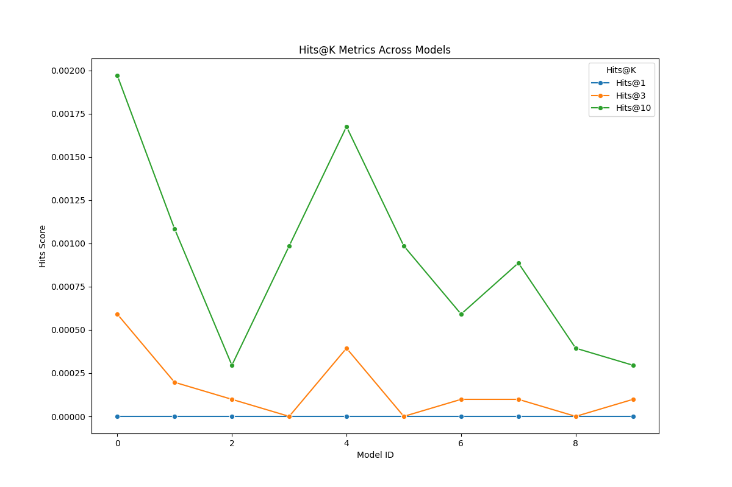
Hits at K: The proportion of correct entities
found in the top K positions.
We focus on K=1, 3, and 10.
Why is it not working?
Reason: too few different relationships
in the graph/entity types
Why is it not working well?

Slide 20
Thank you

